Slide 1
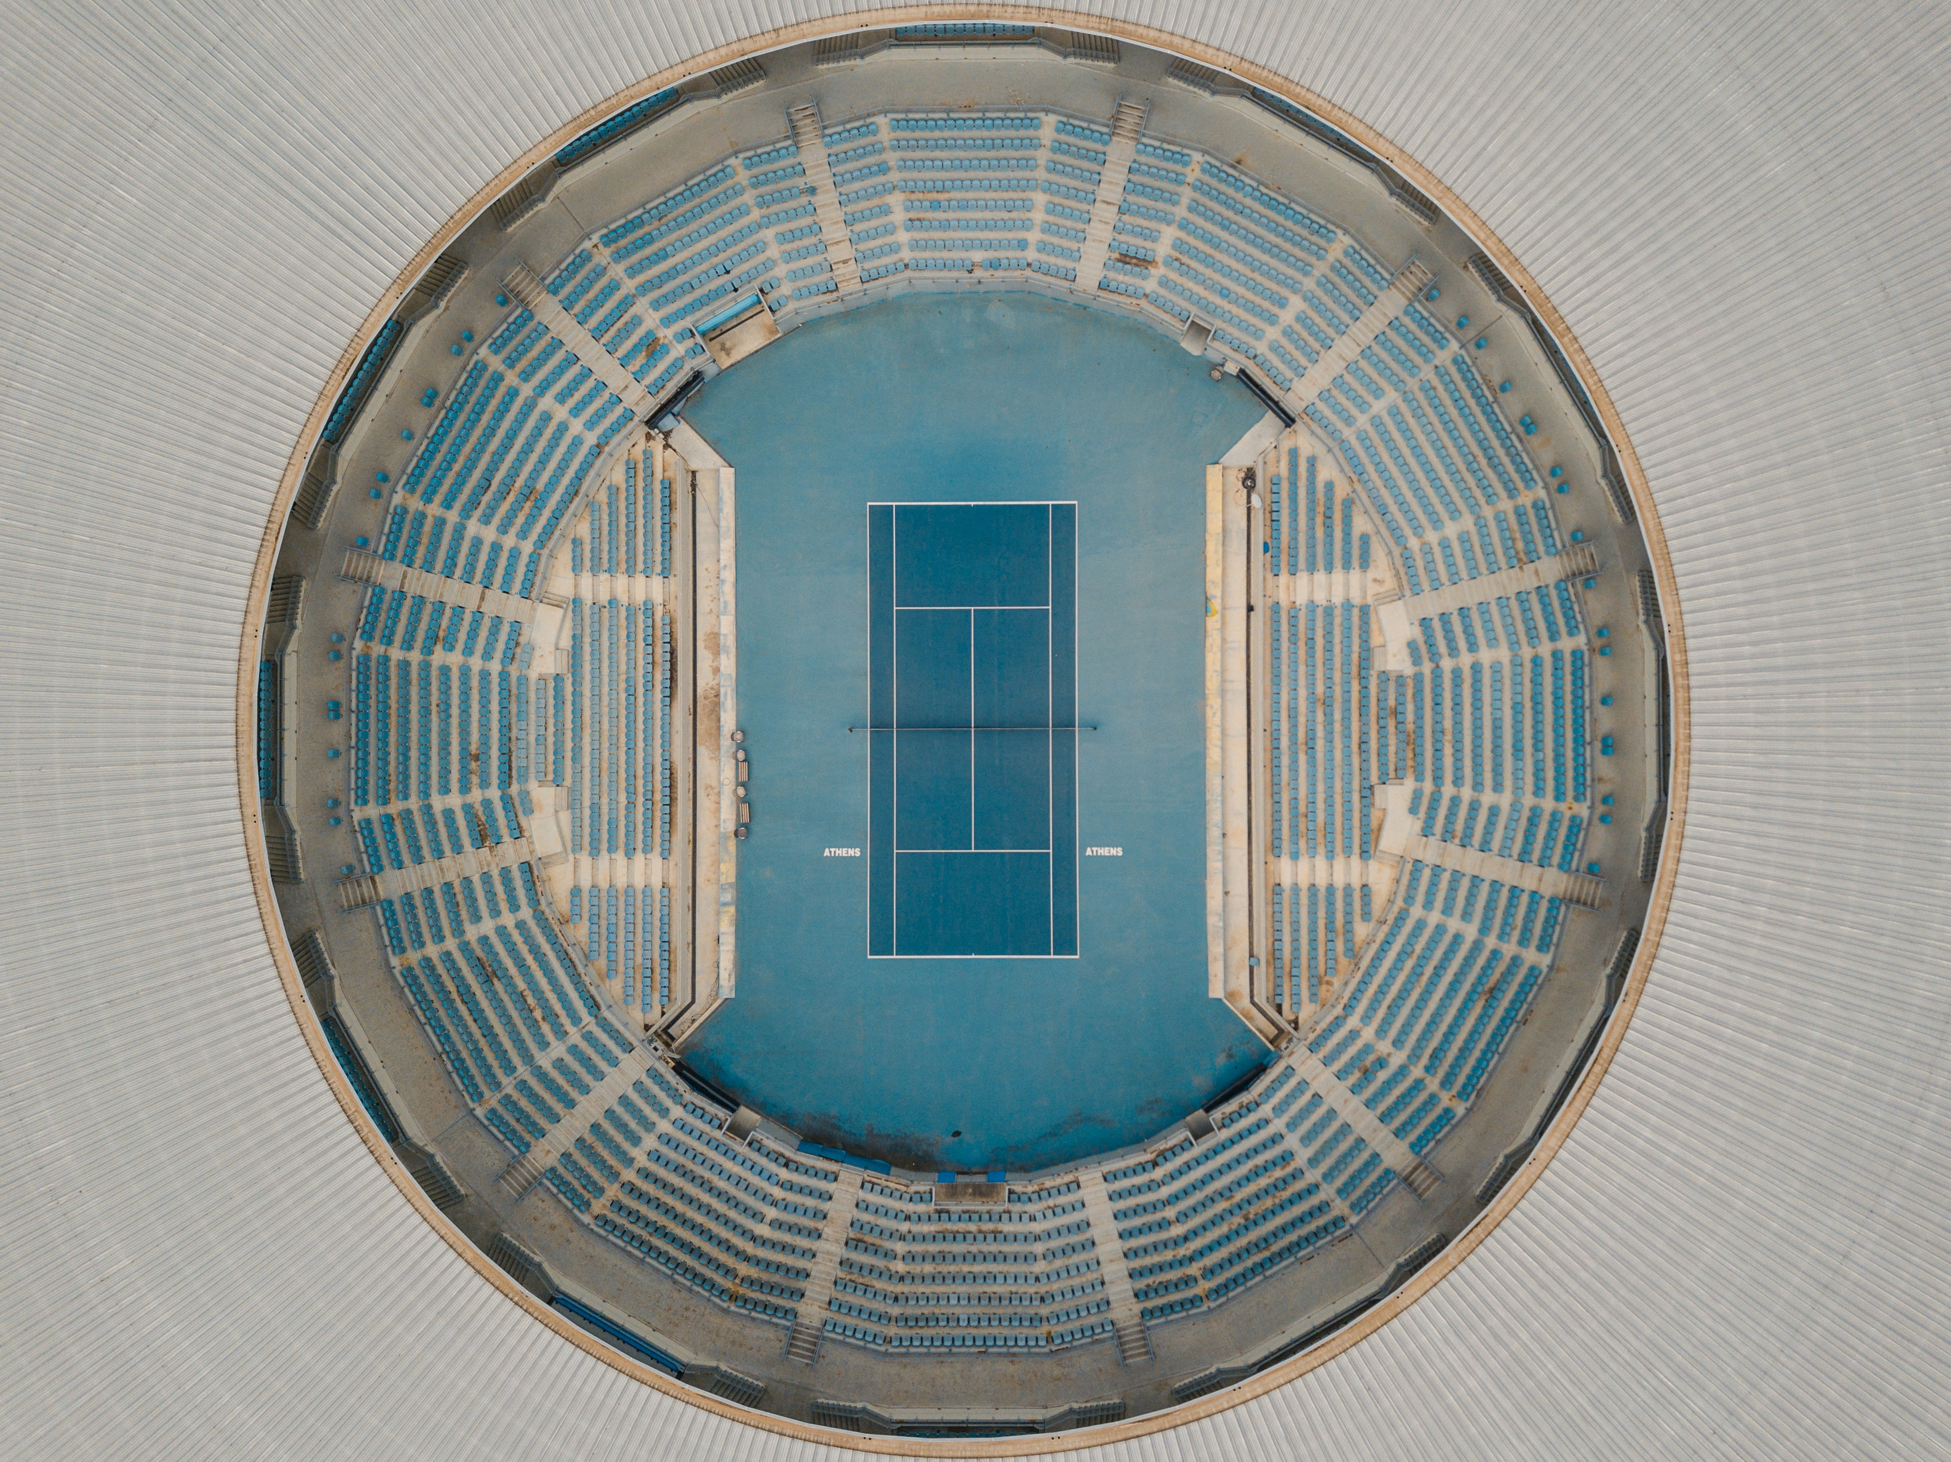
Olympic Predictions
Team 12
John Temple
Hunter Huang
Trey Graham
Tucker FISCHER
Exploring the modern Olympics

Slide 2
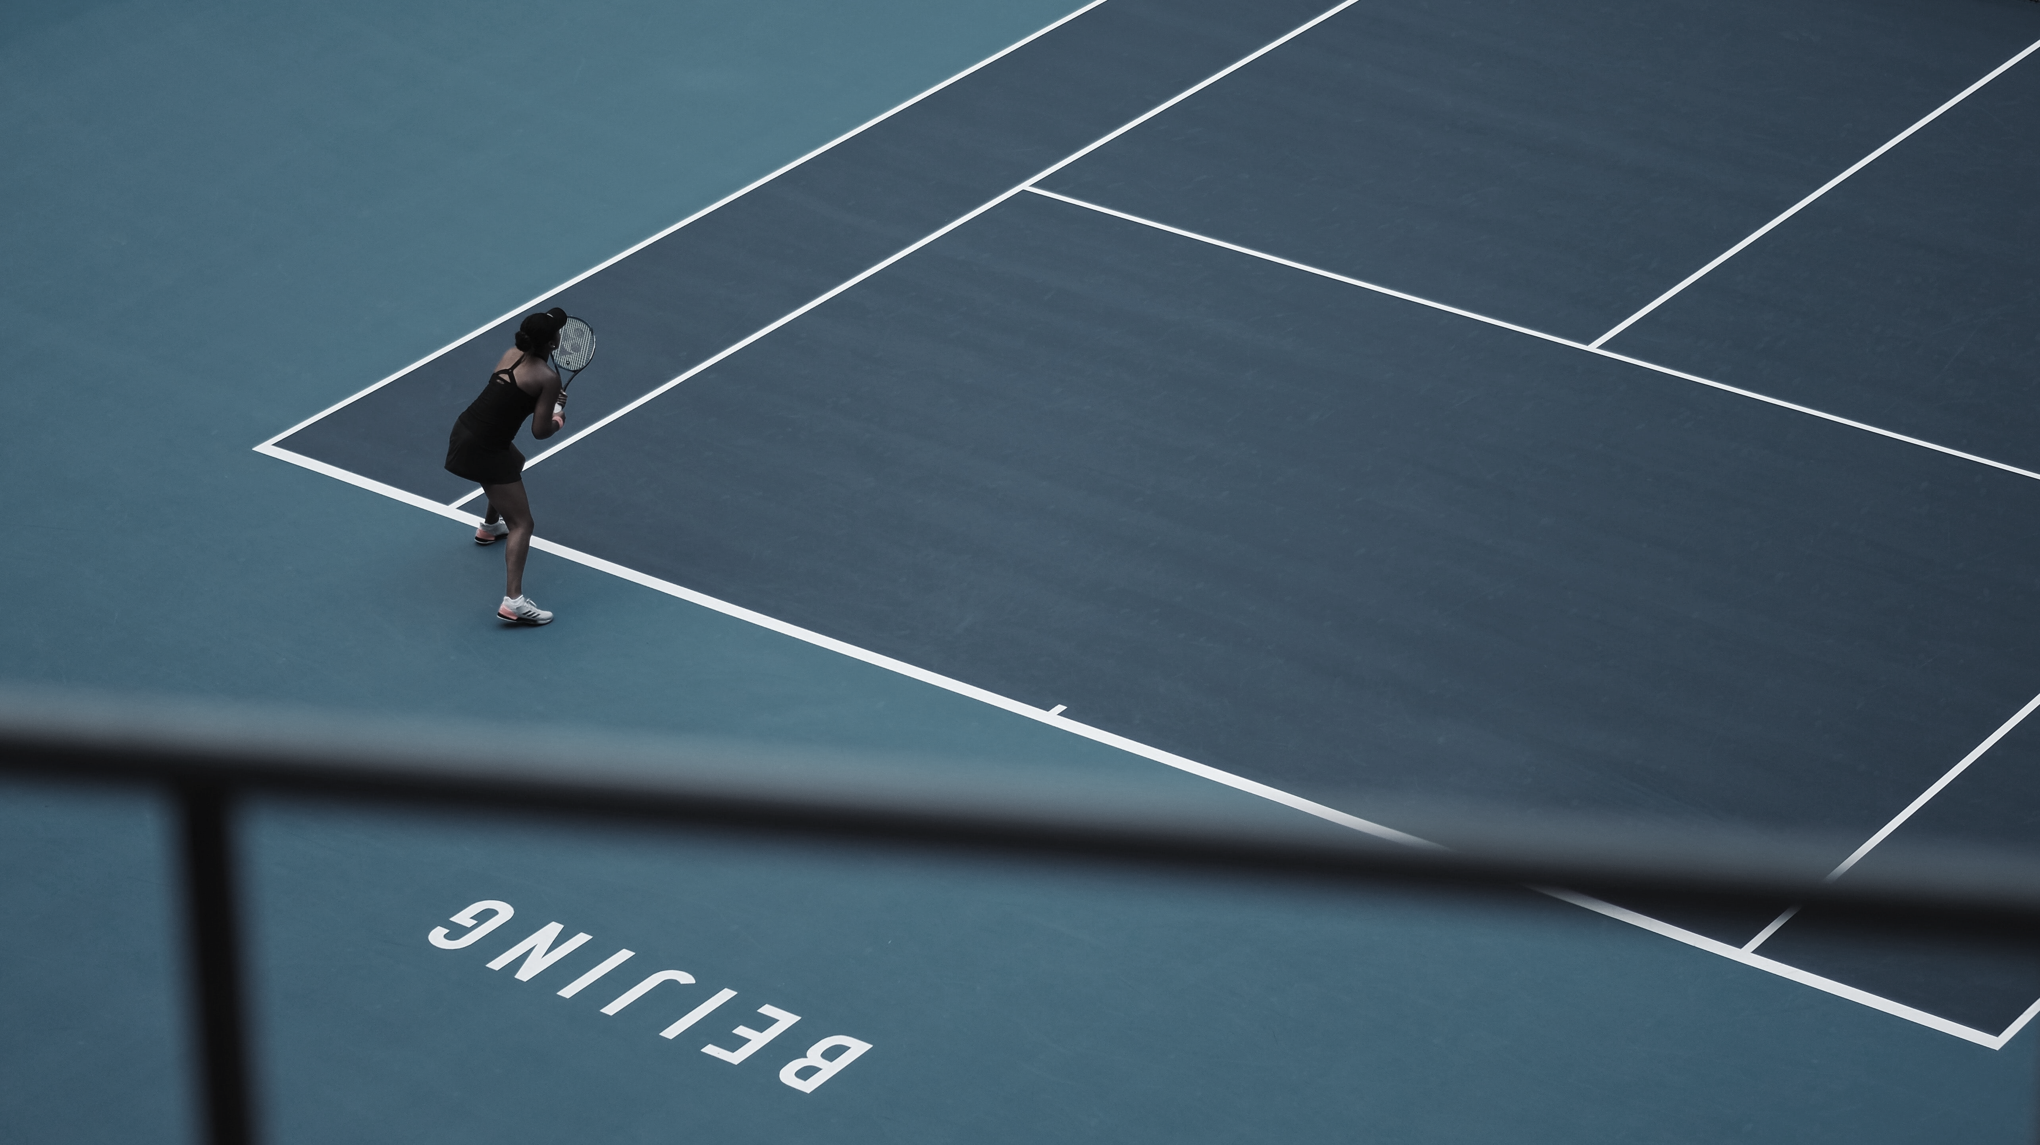
Primary Objective/Questions to be answered
OBJECTIVE
-
EXPLORING THE DATA
-
Categorizing
-
Apply MODEL
-
INSIGHTS
-
COMPARE RESULTS
-
Summary

Slide 3
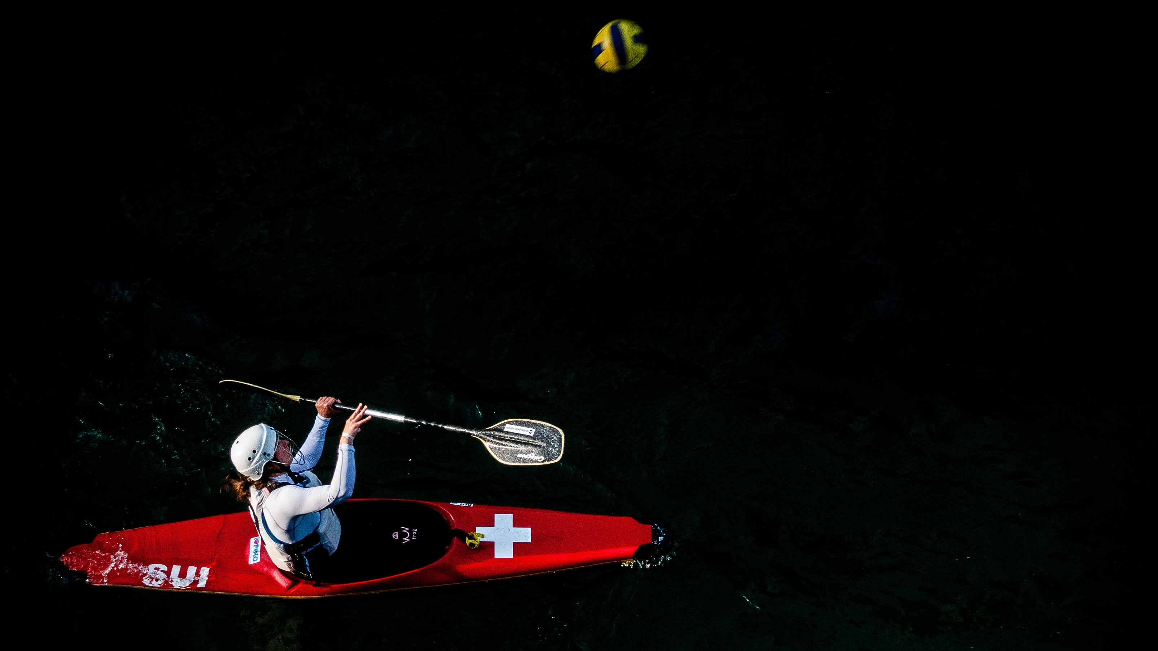
EXPLORING THE DATA
Example Text
OBJECTIVE
-
EXPLORING THE DATA
-
Categorizing
-
Apply MODEL
-
INSIGHTS
-
COMPARE RESULTS
-
Summary

Slide 4
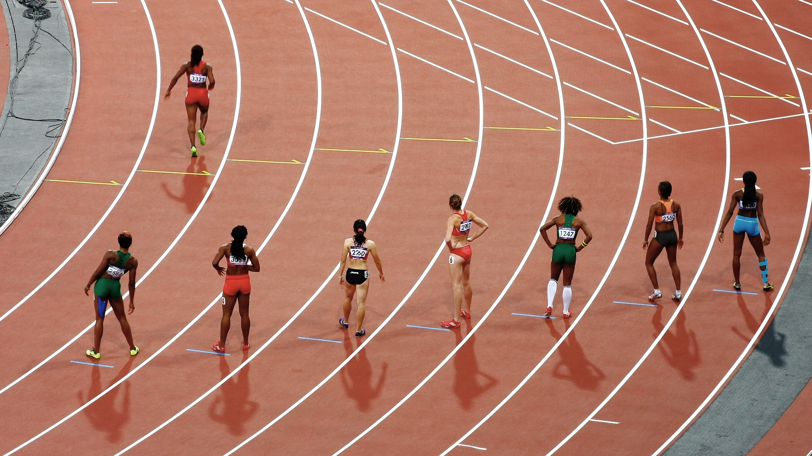
Categorizing the competitors
Example Text
OBJECTIVE
-
EXPLORING THE DATA
-
Categorizing
-
Apply MODEL
-
INSIGHTS
-
COMPARE RESULTS
-
Summary

Slide 5
Categorizing the competitors
Example Text
OBJECTIVE
-
EXPLORING THE DATA
-
Categorizing
-
Apply MODEL
-
INSIGHTS
-
COMPARE RESULTS
-
Summary

Slide 6
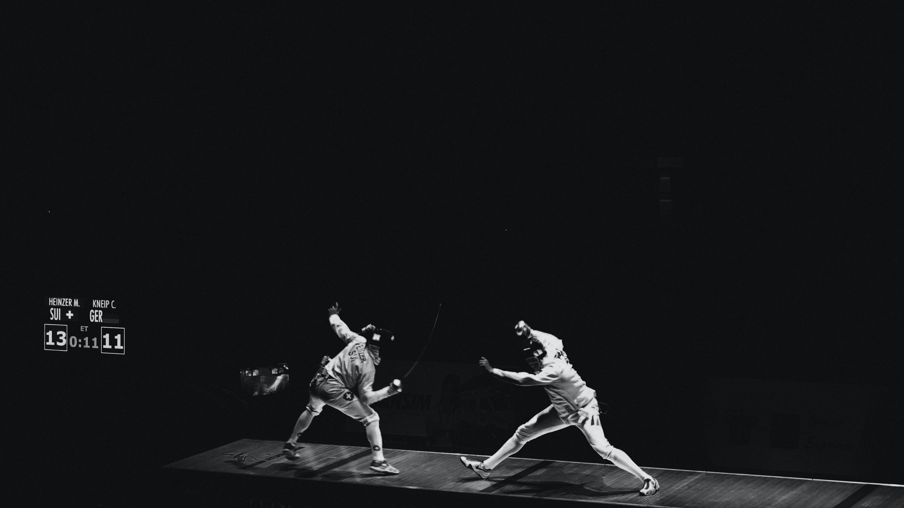
Apply Model to dataset
Example Text
OBJECTIVE
-
EXPLORING THE DATA
-
Categorizing
-
Apply MODEL
-
INSIGHTS
-
COMPARE RESULTS
-
Summary

Slide 7
Apply Model to dataset
Example Text
OBJECTIVE
-
EXPLORING THE DATA
-
Categorizing
-
Apply MODEL
-
INSIGHTS
-
COMPARE RESULTS
-
Summary

Slide 8
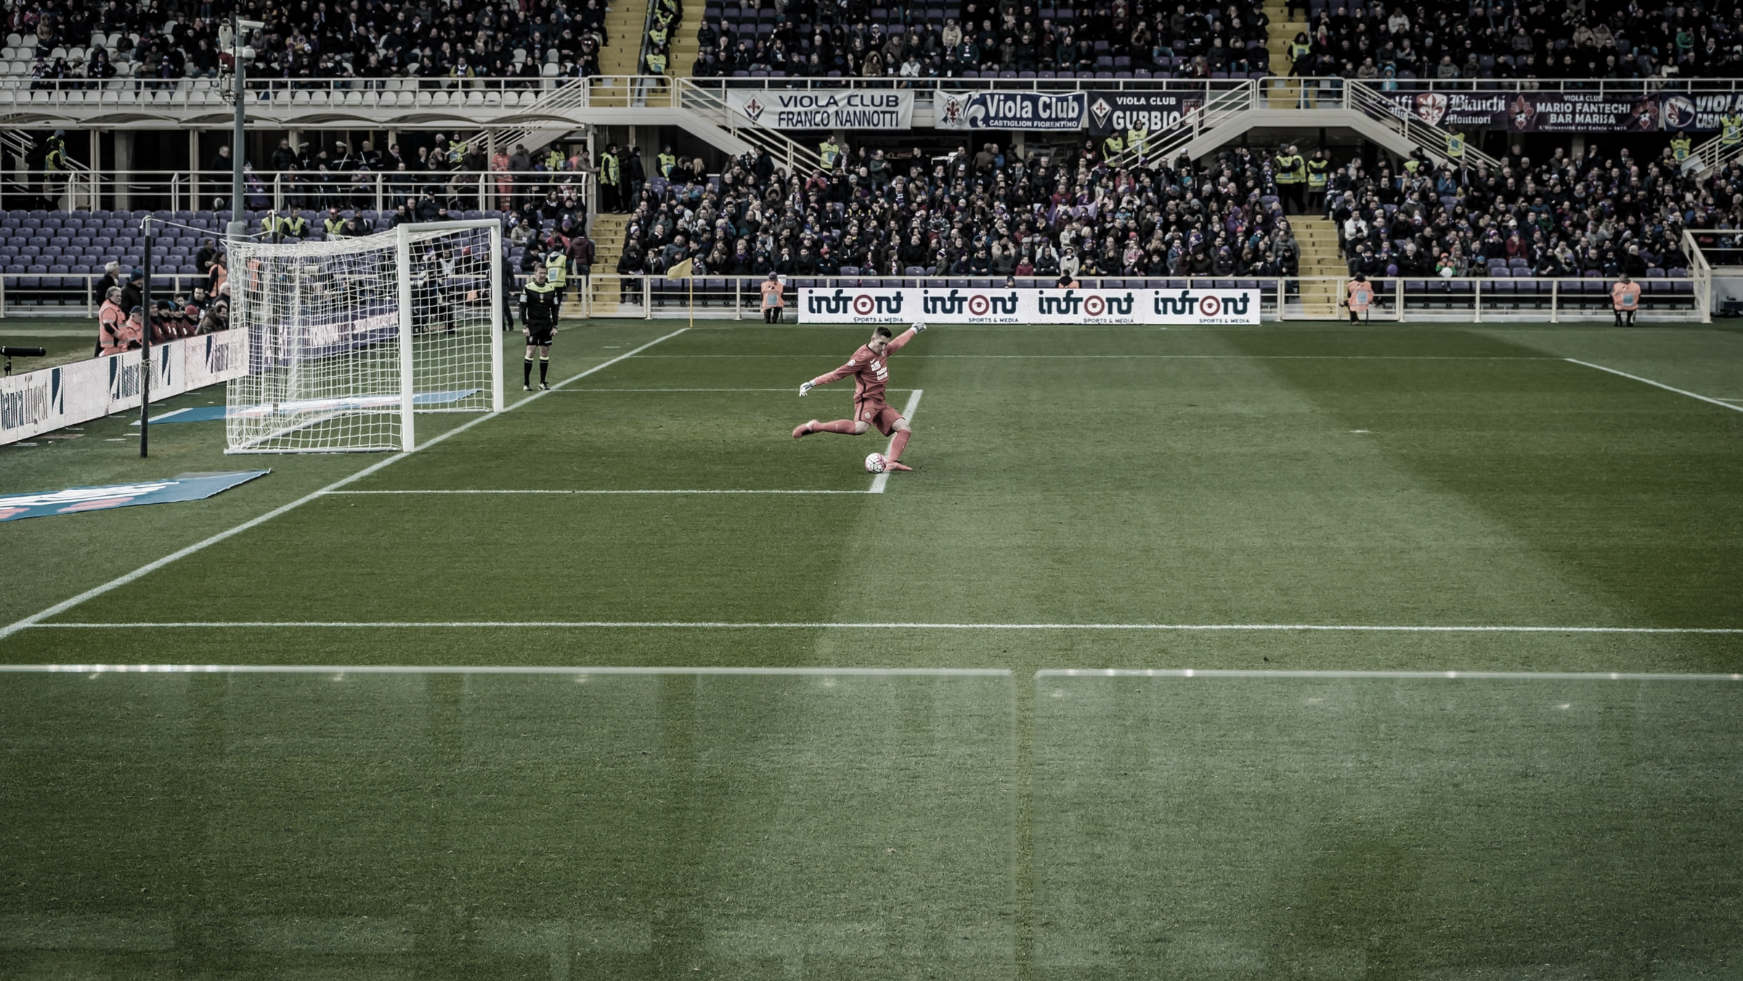
INSIGHTS / Anomalies / Trends
Example Text
OBJECTIVE
-
EXPLORING THE DATA
-
Categorizing
-
Apply MODEL
-
INSIGHTS
-
COMPARE RESULTS
-
Summary

Slide 9
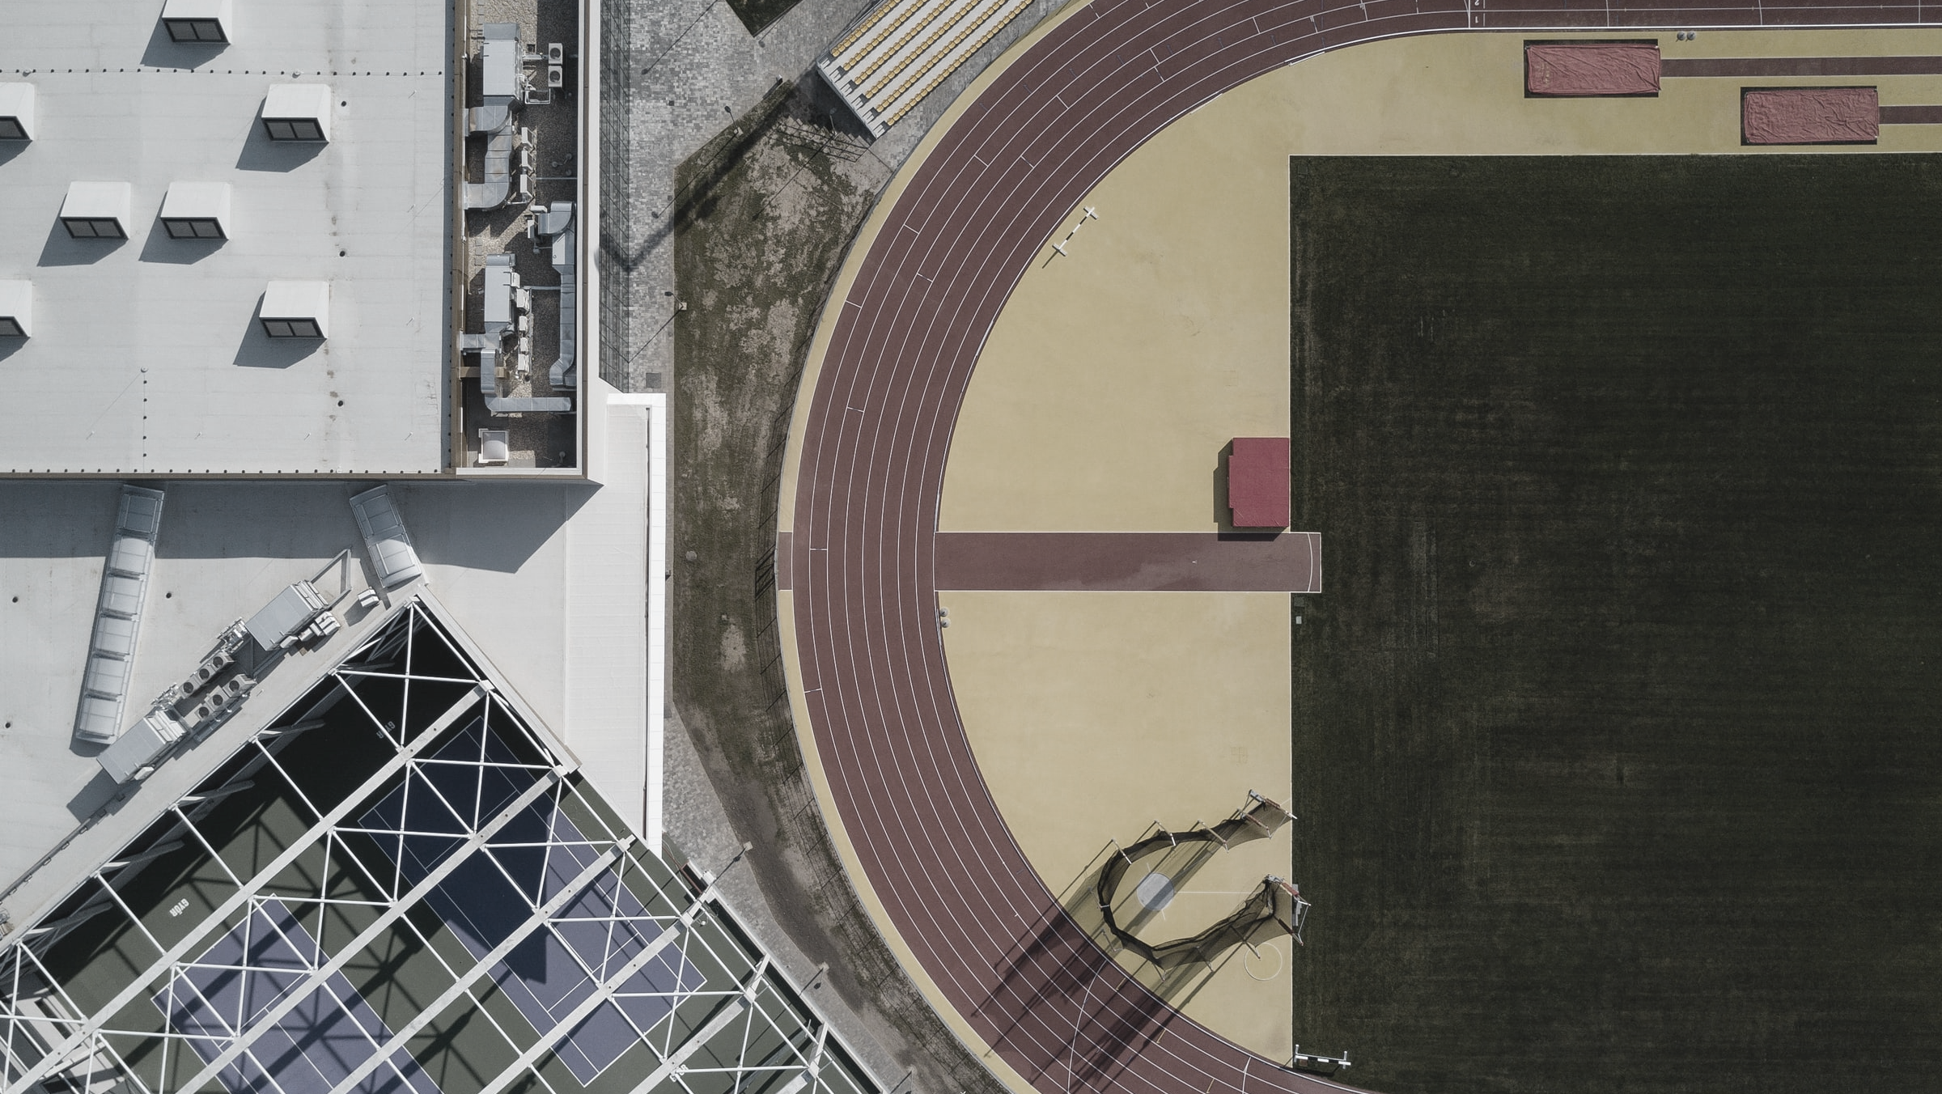
COMPARE RESULTS TO TOKYO 2020
Example Text
OBJECTIVE
-
EXPLORING THE DATA
-
Categorizing
-
Apply MODEL
-
INSIGHTS
-
COMPARE RESULTS
-
Summary

